Slide 1

Presentation Materials Created by Mimetics Inc.
Free use by anyone for non-commercial purposes
Copyrights, Trademarks and other Registered Marks the Property of their Owners

Slide 2
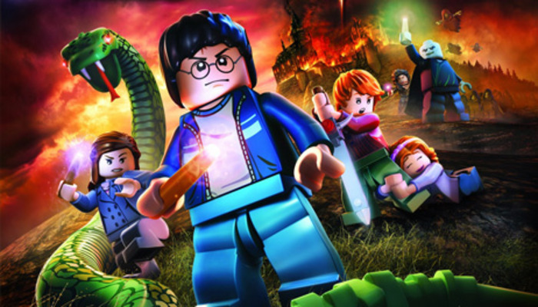
Grade 8 Systems
Class 8 - Class Challenge
Notes:
We want to introduce the Jade Robot and it’s Tools in more detail along with our action plans for it.
It’s interesting, but it’s easy to criticize something when it’s done (especially when you have experience) – a *LOT* more difficult getting it right from the start. Also, preparing this presentation was a great way to review and think about what we should be doing.

Slide 3
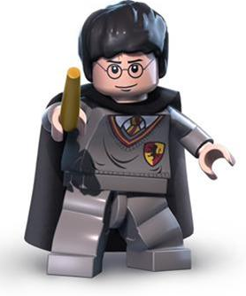
Recap
What are the Steps for Creating a Program?
What is the Robot Program Structure?
What do you do when things go wrong?
Notes:
Can Demo Jade Scratch if people are interested. In doing this product I’ve had a few interesting discoveries – one was going with a simpler programming language actually has a *LOT* of value for an expert like myself.

Slide 4
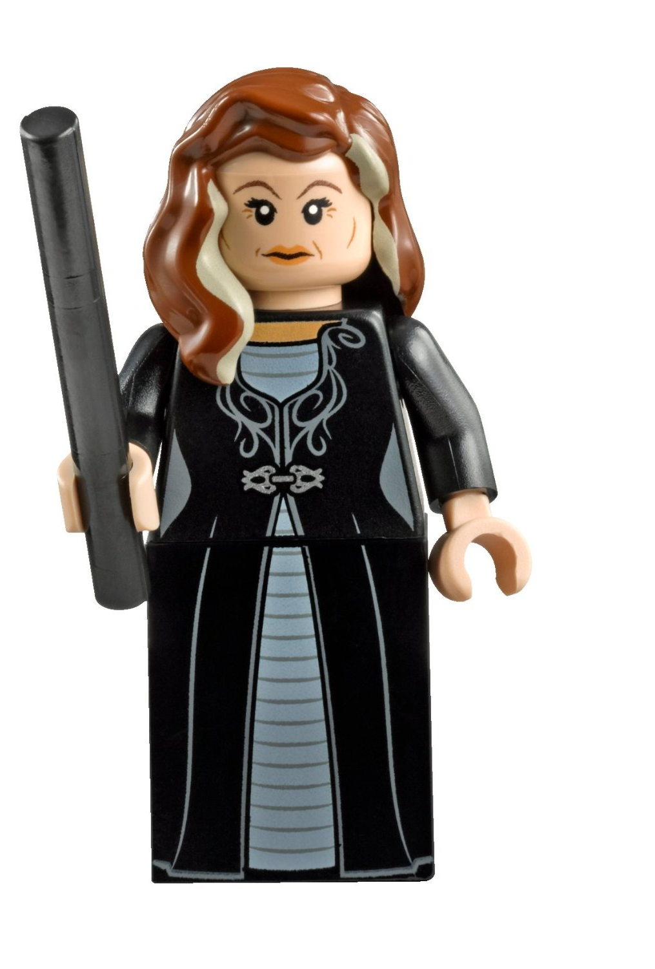
Creating a Program
Get Requirements
Break Requirements into Parts
For Each Part, List Statement Types Needed
Create a Sequence of Statements
Test Statements for Each Part
Work in Sequence and Build Up the Program as the Sum of the Parts
Test Final Program to Requirements
Celebrate!!!
Notes:
Can Demo Jade Scratch if people are interested. In doing this product I’ve had a few interesting discoveries – one was going with a simpler programming language actually has a *LOT* of value for an expert like myself.

Slide 5
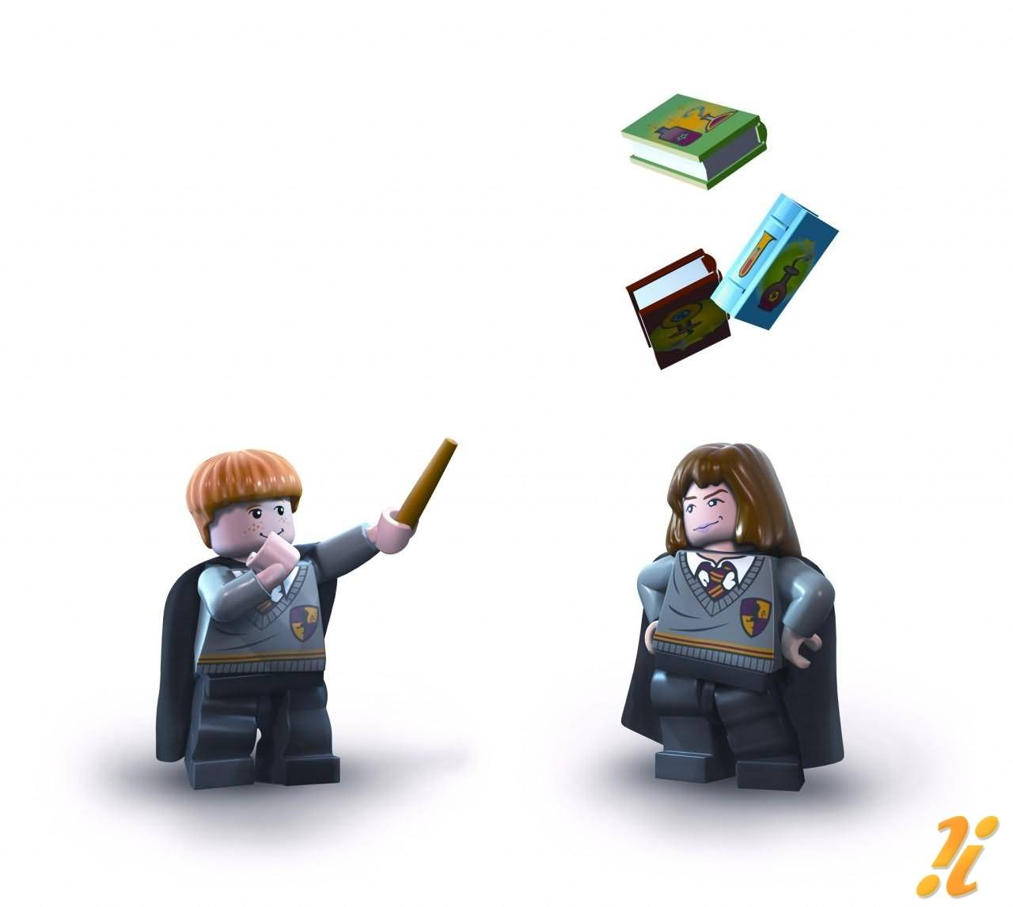
Robot Program Structure
Initialize Robot
Get Input
Process
Repeat (Loop)
Output Processed Inputs
Shutdown Robot
(Stop)
Notes:
Can Demo Jade Scratch if people are interested. In doing this product I’ve had a few interesting discoveries – one was going with a simpler programming language actually has a *LOT* of value for an expert like myself.

Slide 6
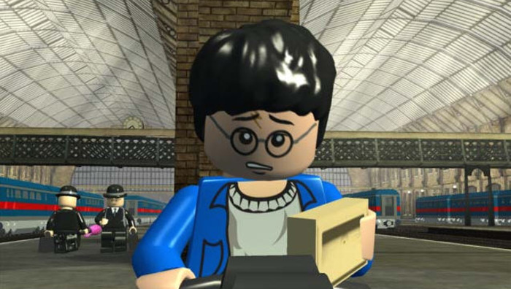
What to do when things go wrong
Notes:
Can Demo Jade Scratch if people are interested. In doing this product I’ve had a few interesting discoveries – one was going with a simpler programming language actually has a *LOT* of value for an expert like myself.

Slide 7
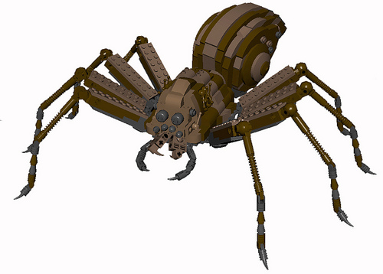
Steps to find a problem
Check Spelling/Statements
Single Step through the Program
Add Display Updates and LED Outputs to Track Progress
Isolate small Parts of the Program and Test Operation
Notes:
Can Demo Jade Scratch if people are interested. In doing this product I’ve had a few interesting discoveries – one was going with a simpler programming language actually has a *LOT* of value for an expert like myself.

Slide 8
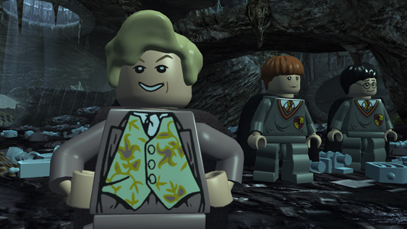
Challenge
Notes:
We want to introduce the Jade Robot and it’s Tools in more detail along with our action plans for it.
It’s interesting, but it’s easy to criticize something when it’s done (especially when you have experience) – a *LOT* more difficult getting it right from the start. Also, preparing this presentation was a great way to review and think about what we should be doing.

Slide 9
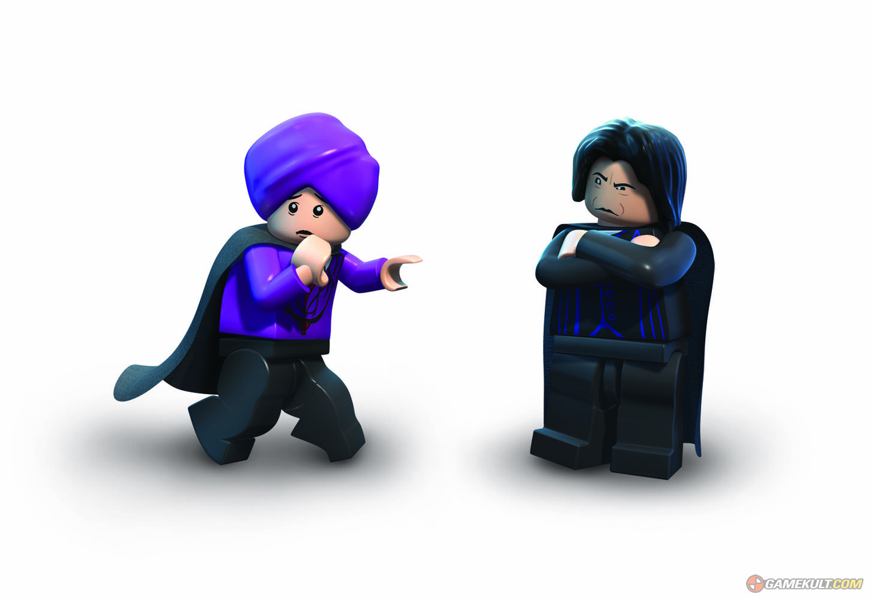
Move Forwards Until Construction Paper Encountered.
If there is an object:
Turn to an angle until Past it
Resume original Direction
Notes:
Can Demo Jade Scratch if people are interested. In doing this product I’ve had a few interesting discoveries – one was going with a simpler programming language actually has a *LOT* of value for an expert like myself.

Slide 10
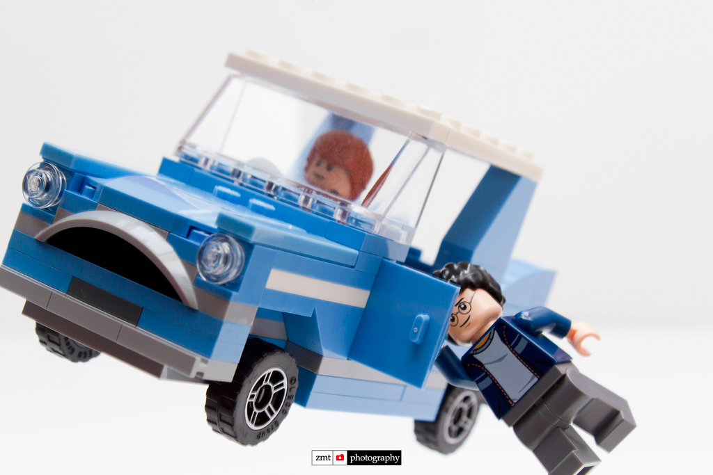
Where is this done in the “Real World”?
Notes:
Can Demo Jade Scratch if people are interested. In doing this product I’ve had a few interesting discoveries – one was going with a simpler programming language actually has a *LOT* of value for an expert like myself.

Slide 11
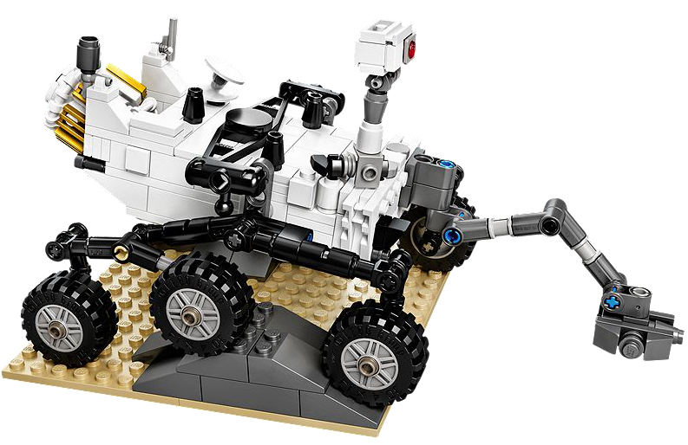
NASA Programs the Curiosity Rover to Look for Water using these types of Programs
Notes:
Can Demo Jade Scratch if people are interested. In doing this product I’ve had a few interesting discoveries – one was going with a simpler programming language actually has a *LOT* of value for an expert like myself.

Slide 12
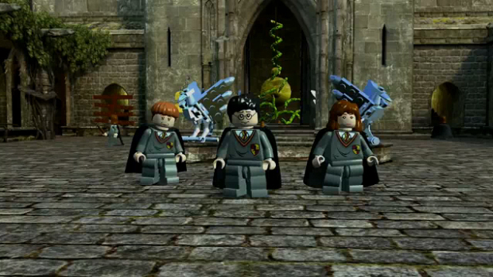
First Part:
Repeatedly Move Forwards using Spectrometer
– When Surface Changes: STOP
Notes:
Can Demo Jade Scratch if people are interested. In doing this product I’ve had a few interesting discoveries – one was going with a simpler programming language actually has a *LOT* of value for an expert like myself.

Slide 13
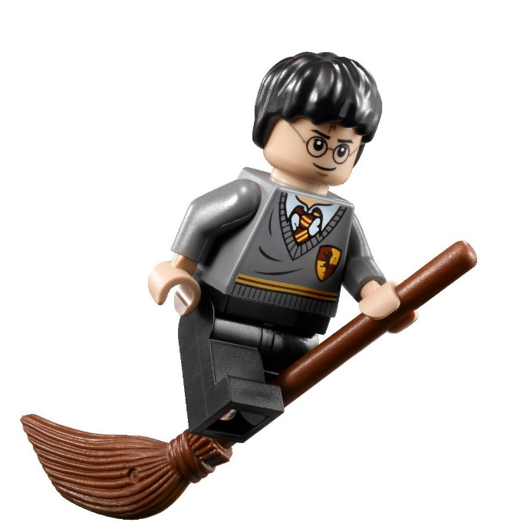
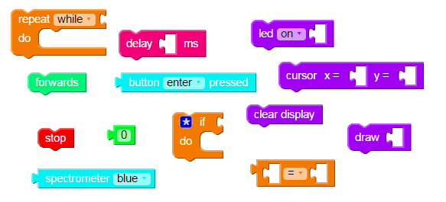
The Scratch Statements you will need
Notes:
We want to introduce the Jade Robot and it’s Tools in more detail along with our action plans for it.
It’s interesting, but it’s easy to criticize something when it’s done (especially when you have experience) – a *LOT* more difficult getting it right from the start. Also, preparing this presentation was a great way to review and think about what we should be doing.

Slide 14
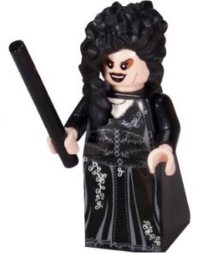
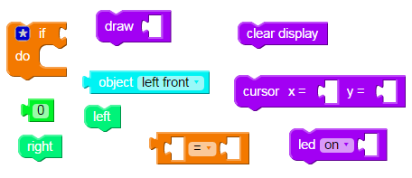
Adding Object Detection:
Notes:
We want to introduce the Jade Robot and it’s Tools in more detail along with our action plans for it.
It’s interesting, but it’s easy to criticize something when it’s done (especially when you have experience) – a *LOT* more difficult getting it right from the start. Also, preparing this presentation was a great way to review and think about what we should be doing.

Slide 15
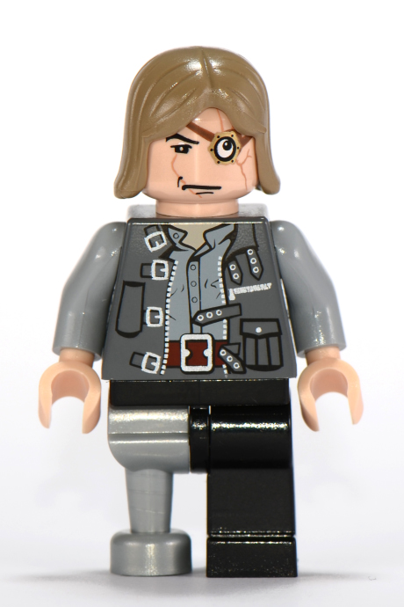
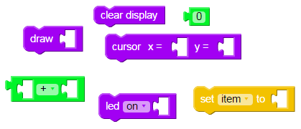
Keeping Track of Movements:
Notes:
We want to introduce the Jade Robot and it’s Tools in more detail along with our action plans for it.
It’s interesting, but it’s easy to criticize something when it’s done (especially when you have experience) – a *LOT* more difficult getting it right from the start. Also, preparing this presentation was a great way to review and think about what we should be doing.

